Slide 1
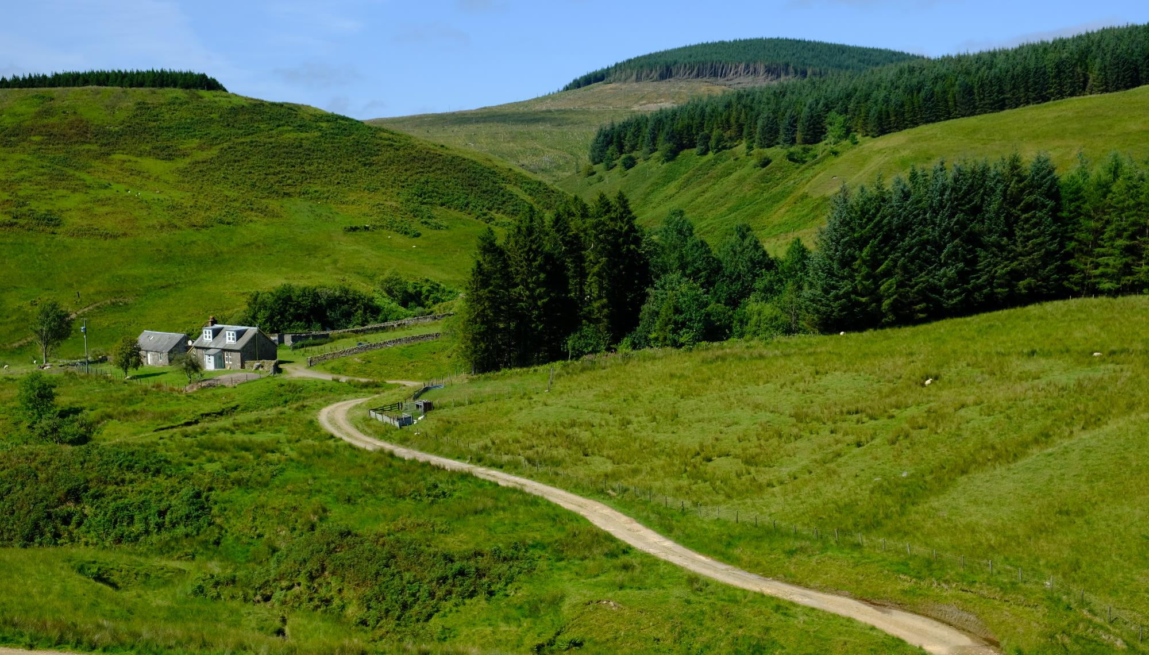
Understanding Rural Britain to 2050
A proposal from Pragmatix Advisory & Trajectory

Slide 2
Contents
Objectives
Context
Approach
Team

Slide 3
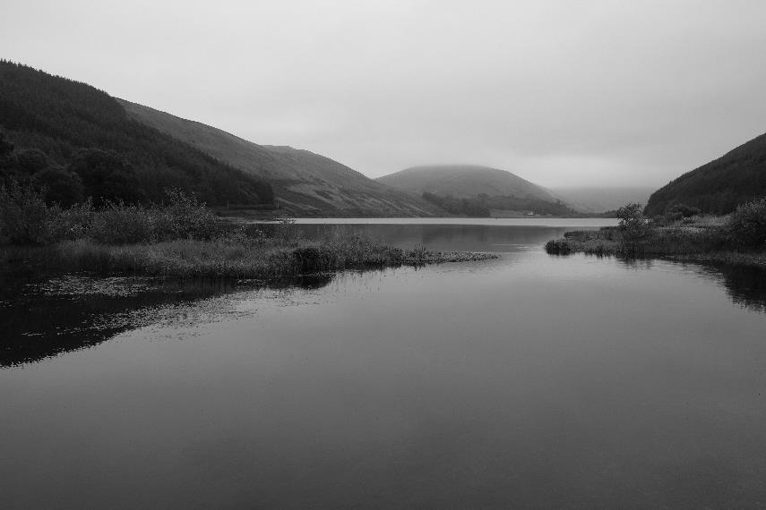
Introduction
Rural Britain is poorly understood at a time when it is undergoing profound change.
Data on rural communities, their life experiences and challenges are limited and often flawed. Our recent experience with policy makers in rural areas has demonstrated that there are critical blindspots and misrepresentations in national data sets.
Farming is undergoing a series of significant changes and faces many new challenges.
Whilst many organisations would like to serve their rural audiences better, they often lack the evidence and insights to do so.
Our aim is to encourage a small group of non-competing organisations to fund an authoritative study into the current and future challenges faced by rural and coastal communities.

Slide 4
Research objectives
The project had two broad objectives:
To provide a detailed and accurate assessment of the issues that rural communities currently face
This objective addresses the current knowledge gap about the lives of rural Britons. Even robust data sources such as the ONS fail to capture the complexity or rural life (for example by failing to consider the seasonality of much rural work). We will address this to create a reliable and accurate analysis of rural and coastal communities. We also want to understand the problems that hold back rural communities – mobility, communications, housing and access to both public services and shops.
Farms are at the heart of rural communities and face a series of evolving challenges from a lack of immigrant labour and haulage to the withdrawal of the Basic Payment Scheme and the introduction of Environmental Land Management Schemes. More positively, the contribution that farmers make is now valued more highly by a public who have appreciated the countryside more through the long months of lockdown and who have come to enjoy staycationing.
Our work seeks to address this gap in knowledge and to equip business to better meet the needs of those working and living on the coasts and in the countryside.
2. To forecast how rural Britain will change between now and 2050
From hybrid working to staycations and rewilding, the countryside is facing a period of significant change. We will forecast the scale of this change and what it will mean for the mix of services that consumers demand – across mobility, telecommunications, last mile delivery, shops, services and infrastructure. We will also consider rural demographics and the economic activity of those working in rural locations. Finally, we’ll consider how behaviours and attitudes are changing and what that means for rural communities in the years ahead.

Slide 5
Areas of focus
Within the objectives, the project had two areas of focus:
Agriculture and the future of farming
Farming faces a number of significant changes ranging from labour shortages and our exit from the common agricultural policy to the impact of both the Agricultural Act of 2020 and the 25 year Environment Plan. Low food prices have forced many farmers to become more entrepreneurial and to diversify – in 2021 the percentage of business turnover from non-farming activities increased from 11% to 16% (NFU Mutual). Holiday accommodation is already the third biggest source of non-farming income and the recent trend towards staycations is likely to continue.
Specifically, the project will focus on trends in farm ownership and income from non-farming activities (e.g. property and retail).
2. Mobility and transport
So much of the discourse around mobility is urban-based. A lack of public transport is disempowering for rural communities and limits opportunities. While the infrastructure for electric vehicles is growing along arterial routes and in cities, facilities in the countryside are sparser. For young people in particular, this limits opportunities and encourages a move to urban areas.
Decarbonising transport is easier to achieve in towns than it is in the valleys, glens and dales. We will explore transport needs and how they are changing.

Slide 6
Key themes
Sustainability
Climate emergency
Sustainable farming
Impact of Agriculture Act
Food security
EV network
Mobility & communications
Public and private transport
Last mile delivery
Digital & telecommunications delivery
Farming & rural economy
Entrepreneurial farmers diversifying their businesses
Multiple impacts of Brexit
Leisure & tourism
Rural economies vs rural communities.
Society
Ageing
Migrant labour and farming
Cost of living
Where government investment is being targeted
Demand for housing & housing stock

Slide 7
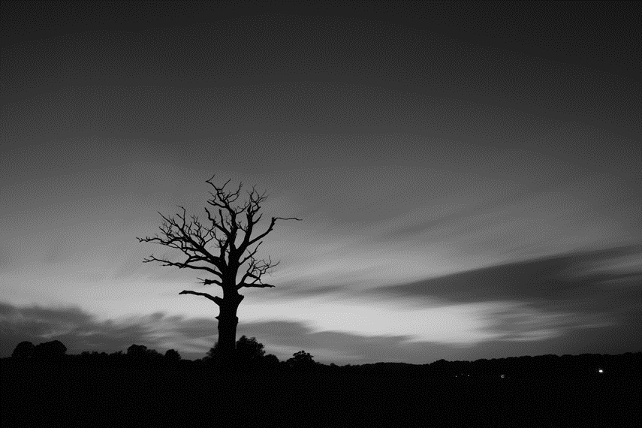
Context
Rural Britain has undergone significant change in the last twenty years. The next ten years will see even greater change from factors such as these:
Brexit and freedom from the Common Agricultural Policy
The Agriculture Act of 2020
Labour shortages
Environmental Land Management schemes
A greater number of people wanting to visit and live in rural areas
The government’s “levelling up” agenda

Slide 8
Context
Far from being an unchanged bucolic idyll, rural Britain has undergone significant change in the last twenty years. We anticipate increasing disruption in the years ahead, from a number of sources including; the Planning Bill which is due to come before parliament shortly, the government’s vaguely-defined levelling up agenda, changed migration flows, labour shortages, the Agriculture Act of 2020, environmental measures such as the proposed planting of 30,000 hectares of trees by 2024 and the government’s response to the Dasgupta Review of the economics of biodiversity.
The impact of ‘hybrid working’ makes rural living a more attractive and feasible option for those currently residing in urban and suburban Britain. Second homes have priced some local youngsters out of some locations. We want to understand how the populations of rural areas are changing and what the consequences are.
Meanwhile the 2020-21 lockdowns have made many people more appreciative of the natural landscape – 71% of Britons feel fortunate to be able to access the countryside and 53% claim that they are more likely to seek out leisure and tourism in the UK than travelling abroad. This is likely to drive staycations and create business opportunity. It also means that British people will be more resistant to development in the green belt and countryside.
2021 is a pivotal moment for rural Britain and an ideal time to conduct a rigorous research and forecasting programme.
Notes:
https://www.nfuonline.com/news/latest-news/new-survey-shows-visiting-british-farmland-benefits-mental-health/

Slide 9
Approach
Our motivation to start this project was the realisation that there is little or no robust data to describe the needs of British people living in the countryside or on the coasts.
We’ll address the knowledge gap through a multi-phase programme that uses qualitative and quantitative primary research along with expert interviews. In addition, we will use workshops as a way of developing implications. Modelling exercises will allow for market sizing both now and in the future.

Slide 10
Approach; research stages
1. Immersion
Understanding what you – and your stakeholders – want from the project. Identifying key information needs.
2. Knowledge review
A detailed review of existing literature and data. Identifying gaps that we can fill.
3. Qualitative research
This stage will help us develop the questionnaire for stage four.
We will work with FieldMouse Research who are specialists in conducting rural qualitative research. Their knowledge will help us create a strong discussion guide.
Expert interviews.
4a. Quantitative research (online)
We have created an online panel of c. 1,750 respondents. This is a UK sample.
5. Workshops
We believe that the most important stage of a project is the development of implications and we propose to work with the project subscribers to identify consumer change that creates opportunities for your business.
6. Modelling
Creating forecasts to 2050.
Market sizing.
Forecasting the contribution rural Britain will make to the UK over the next thirty years.
4b. Quantitative research (offline)
Recognising that some communities are poorly served by broadband, we will also conduct telephone interviews.
We will invite all project sponsors to participate in each stage of the project. From our initial discussions with potential partners, we know there
is a demand for networking and collaboration between the parties and we will facilitate this.

Slide 11
Research methods: farming
To understand farming now:
We plan to conduct both qualitative and quantitative research through FieldMouse Research, an agency that was set up with the specific intention of understanding rural consumers better and to seek out those voices that are never normally heard.
FieldMouse has pioneered an innovative approach to research with farmers through the creation of an online quantitative panel of highly engaged and verified farmers – Opinion Harvester. This tool provides two things – the ability to conduct online quantitative surveys with c.500 British farmers and then the option to contact members of that sample for deep-dive qualitative research (such as focus groups and depth interviews). This allows us to quantify issues and then to explore them in depth.
For this project we propose to use both quantitative and qualitative research to create a detailed picture of how farming is evolving.
To understand farming in the future:
While farmers can give us a detailed picture of their current lives, we will use experts to create a credible and informed view of the future of the business. Interviewees will be diverse - with stakeholders from central government and devolved administrations, businesses, charities and NGOs.
We also welcome your suggestions for interviewees.

Slide 12
Team
Three specialist agencies will combine resources to carry out this work:
Trajectory Partnership: insight & foresight
Pragmatix Advisory: developing strategy through the intelligent use of research
FieldMouse Research: identifying and recruiting rural respondents for qualitative research

Slide 13
The research team
Pragmatix Advisory was founded to help businesses, trade associations and public bodies around the world overcome their biggest challenges through the intelligent and pragmatic use of research and analysis.
Pragmatix help clients understand the implications of a changing business environment and make their case to investors, regulators, politicians and other audiences. They help them plan for the future through strategy development, forecasting, market sizing, scenario analysis and stress testing.
Recently, Pragmatix worked with a consortium of rural partners to assess the Treasury’s Green Book – the latest of several rural research projects.
FieldMouse was launched in 2018 to meet a strong need for the provision of qualitative research and recruitment in rural areas.
Rural voices are seldom heard in research projects and FieldMouse addresses this need for an increasing number of clients.
Based in rural Montgomeryshire in Wales, FieldMouse connects researchers to the full range of country dwellers; farmers, plumbers, lawyers, CEOs, artists, gamekeepers, pensioners and students.
Trajectory is a specialist insight and foresight agency. All their work involves monitoring trends in consumer behaviour and attitudes as well as understanding the drivers of change.
Established in 2008, Trajectory uses a variety of techniques to understand consumer truths around the most sensitive of topics. Clients include RBS, HSBC, Greene King and the BBC.

